Slide 1



Radiant IT Services
News Website
Project Name
The Daily Brief
Submitted By
Aishwarya Goriwale
Harsh Daware
Guided By
Monika Jadhav

Slide 2

Content
Abstraction
Introduction
Objective
System Requirement
Diagram
Documentation
Drawback
Future Scope
Conclusion

Slide 3
Abstract
Now-a-days we live in age of Information Communication and Technology. We can’t think a single moment without technology. From Morning to night, we need, we need help of the technology. This is the revolutionary time of computer technology. Most of the works depends on web applications.
For this reason, anytime, anywhere, anyone can access a website by internet at low cost and we can find our expectable and most update information from website. At present information is one the most valuable resource of the current world. We have developed our project so that we can aware the people.

Slide 4

INTRODUCTION
News Website allows customers to read up to date news related to many fields like Entertainment, National, Sports, Political, Bollywood, Education , Jobs and Many More…
Without any Payment or login. He / She can also contact us to give suggestion and can also give us feedback related to our site.
New News can be added or post only by the admin and only admin have the authorized to update or delete any news.
Admin have the right to give authority to other for news update, add
or delete.

Slide 5

Objective of Project
The objective of this project is to develop a web application for News Website that can aware the people.
The Objective of this project is to provide the daily news
The Objective of this project is to provide breaking news.
It makes use of various technologies to get required crime oriented information more quickly, easily, colorfully and attractively.
Dynamically provides facility.
To add any new information without any complexity.

Slide 6
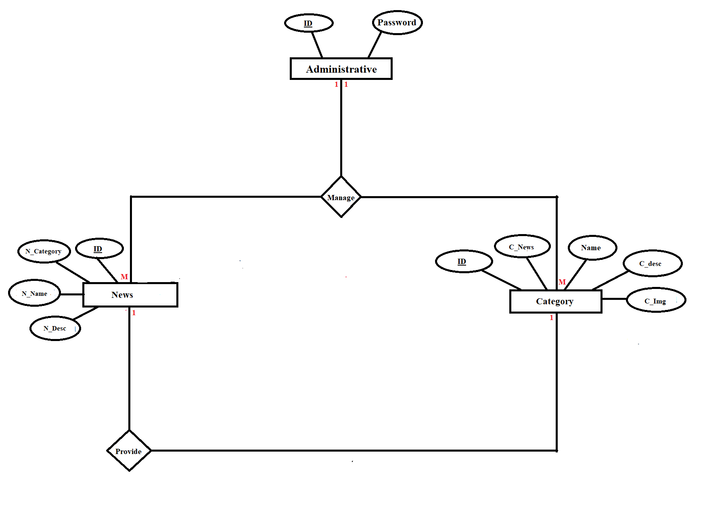
ERD
Diagram

Slide 7
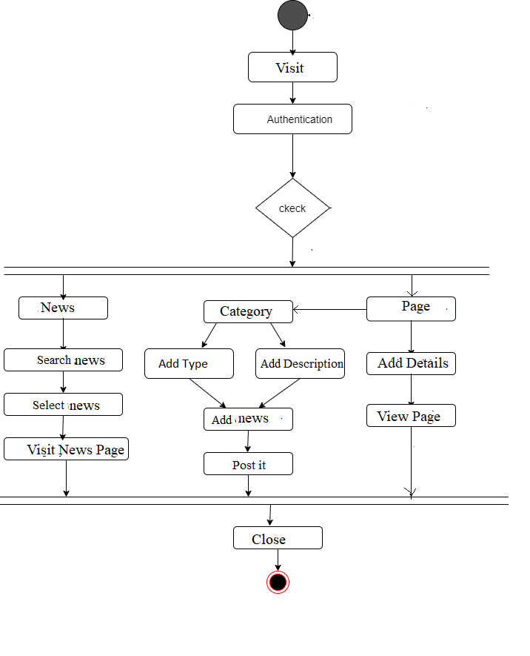
Activity
Diagram

Slide 8
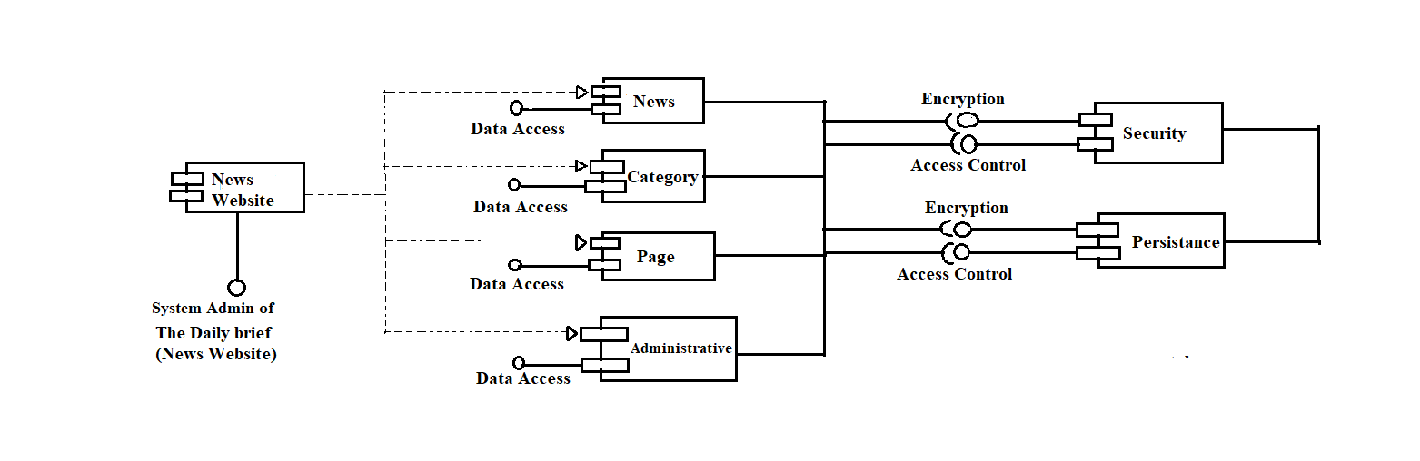
Component
Diagram

Slide 9
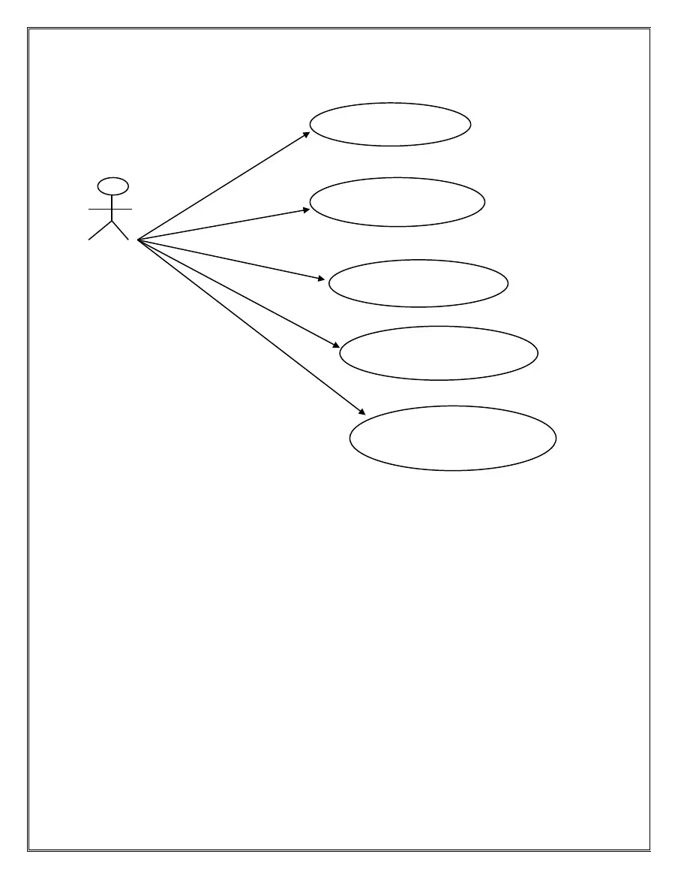
Visit News Portal
Use
Case
Model
Search For News
USER
Visit News Category
Leave feedback for Page
View Contact And About Us Page details

Slide 10
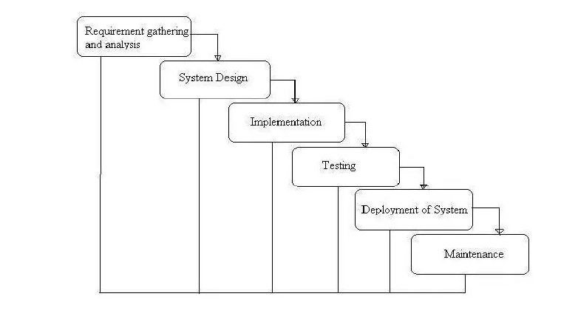
Waterfall Model

Slide 11
Documentation
(Screen Shots)

Slide 12
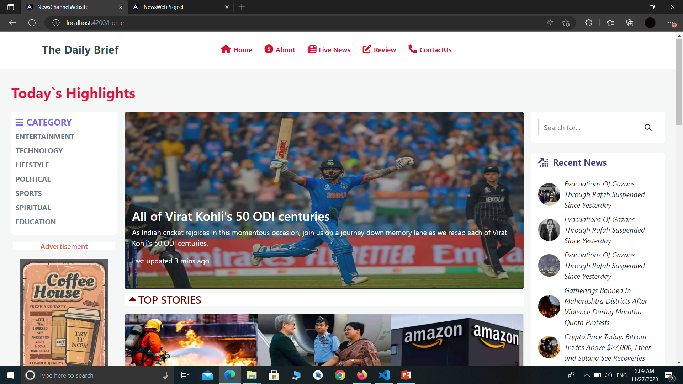
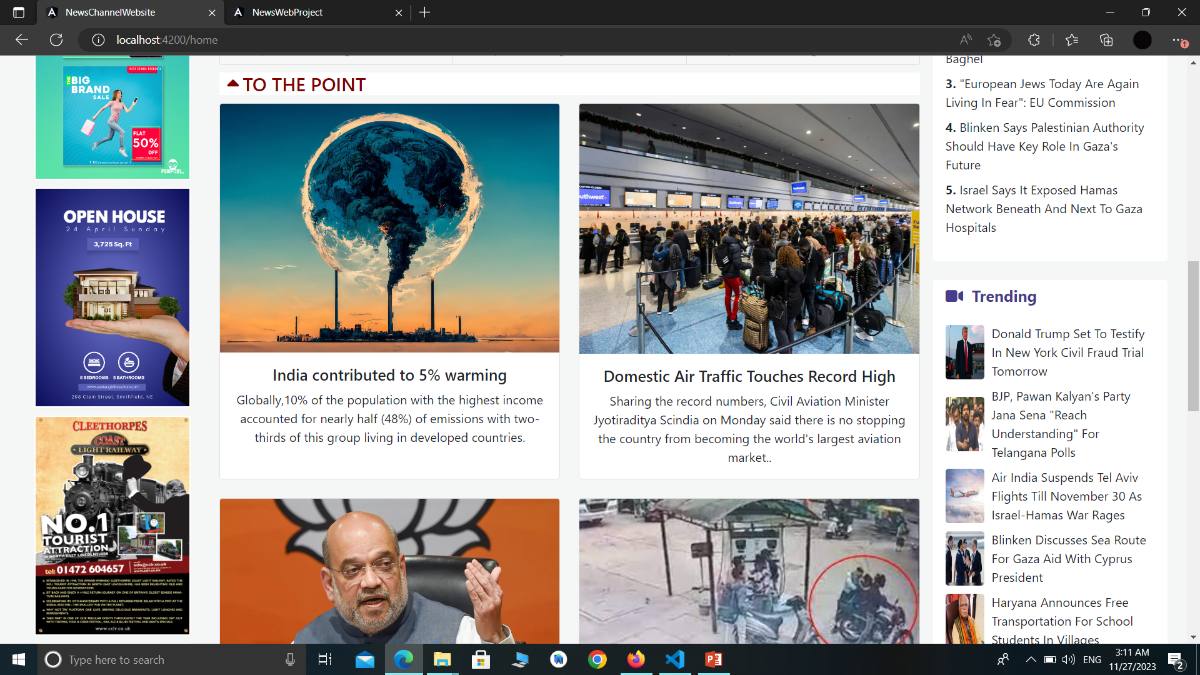
Home Page

Slide 13
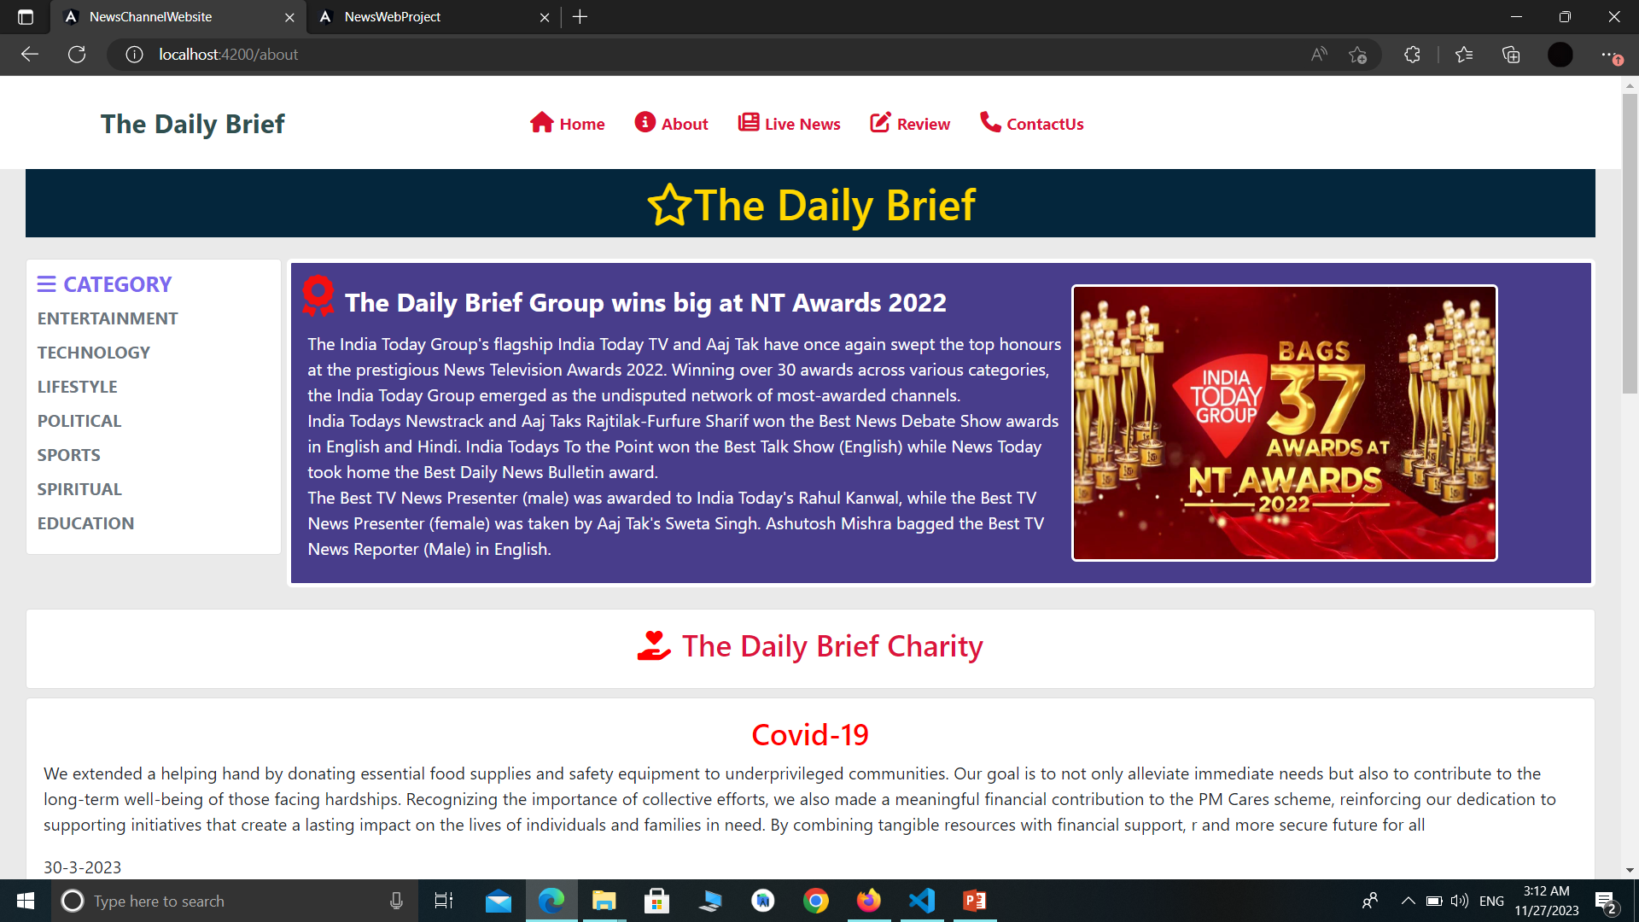
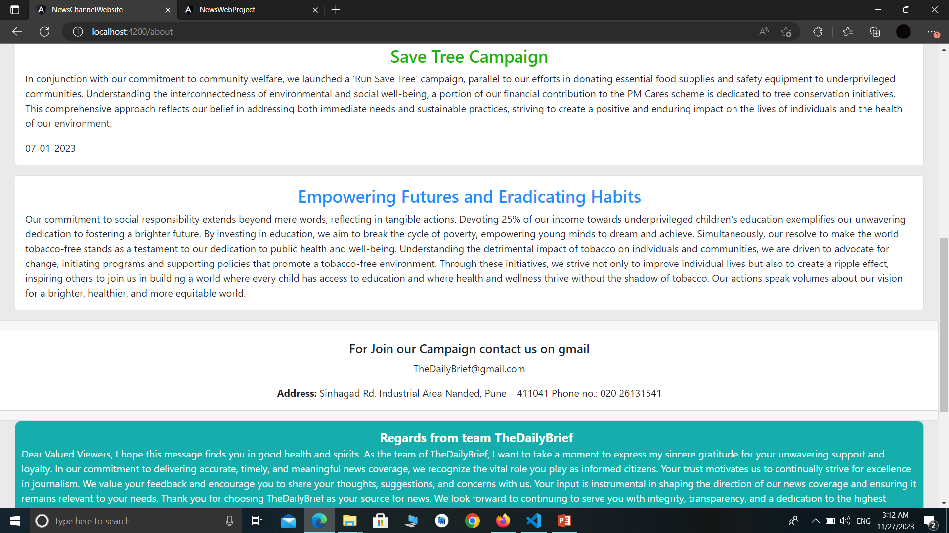
About-Us
Page

Slide 14
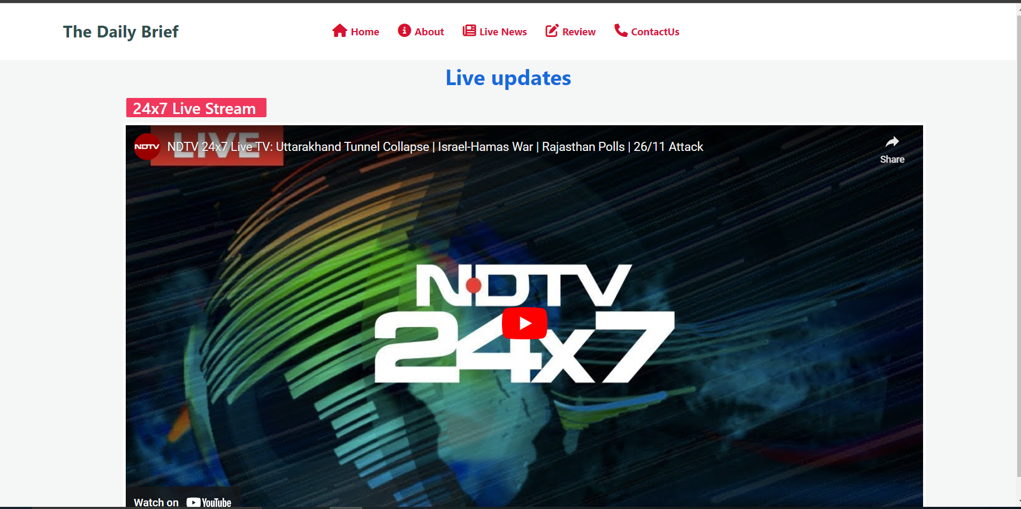
Live News

Slide 15
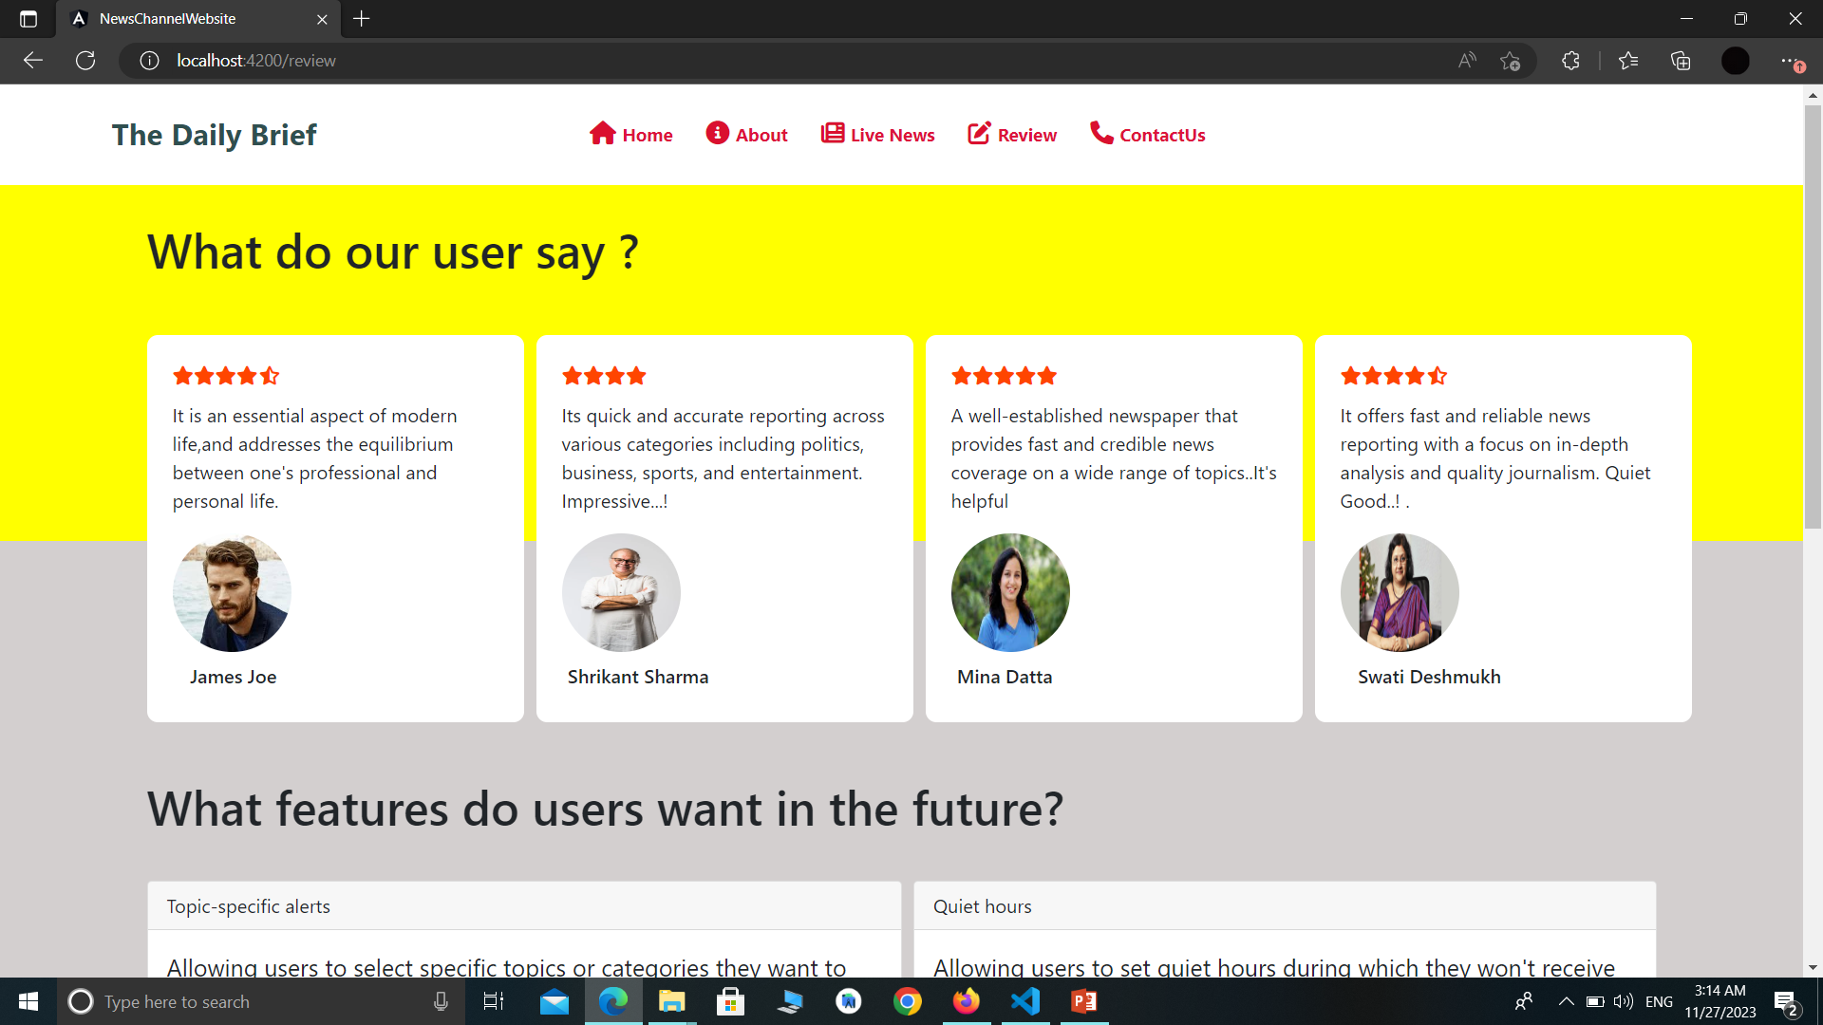
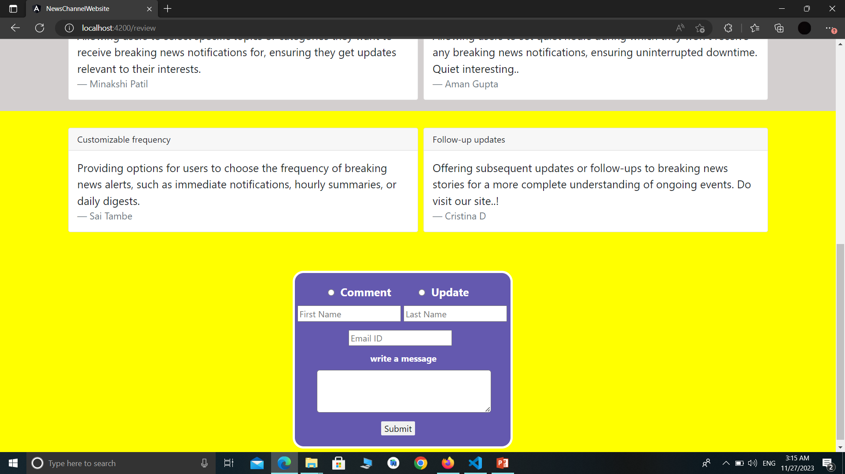
Review Page

Slide 16
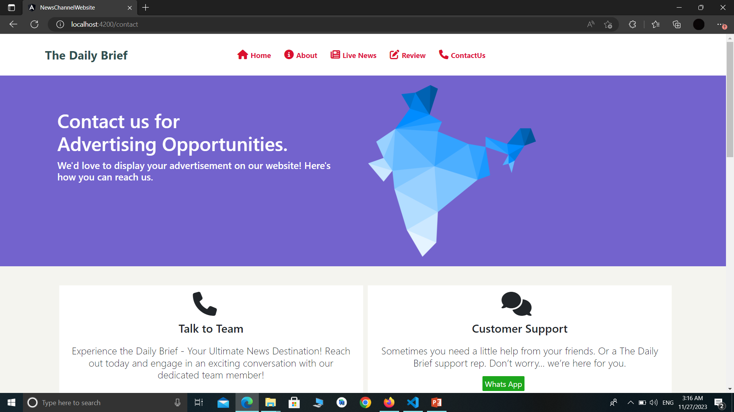
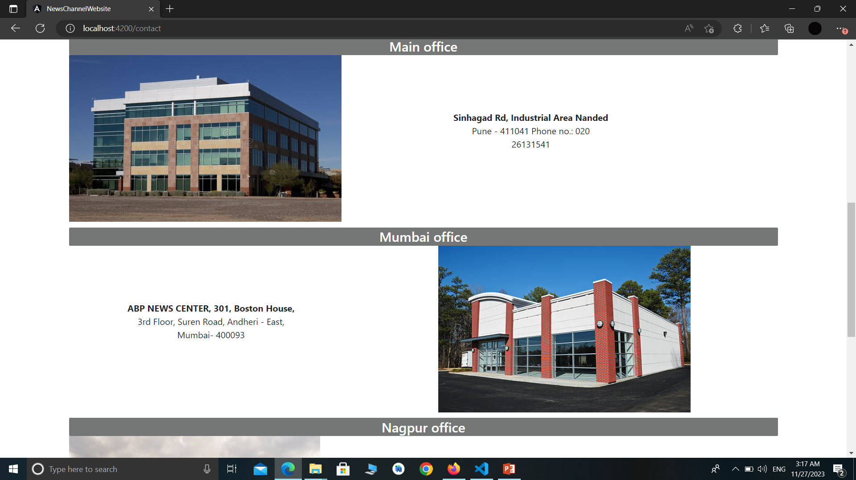
Contact – us
Page

Slide 17
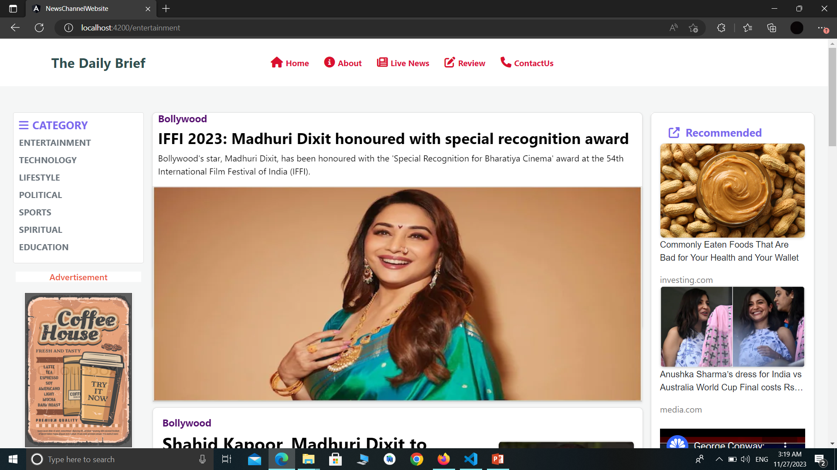
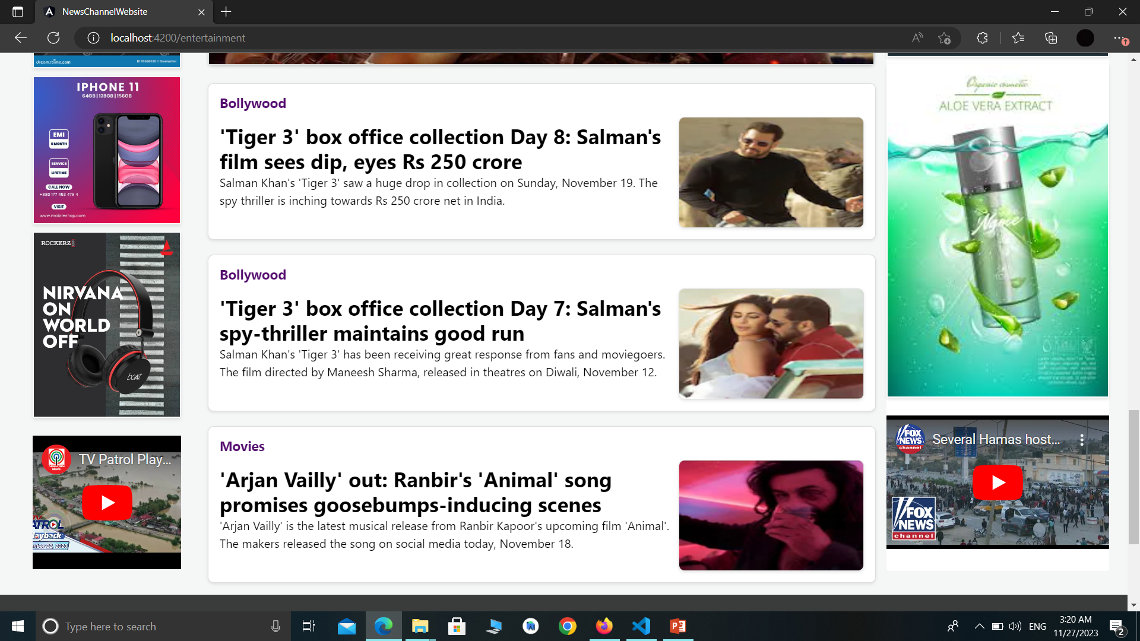
Entertainment
Category

Slide 18
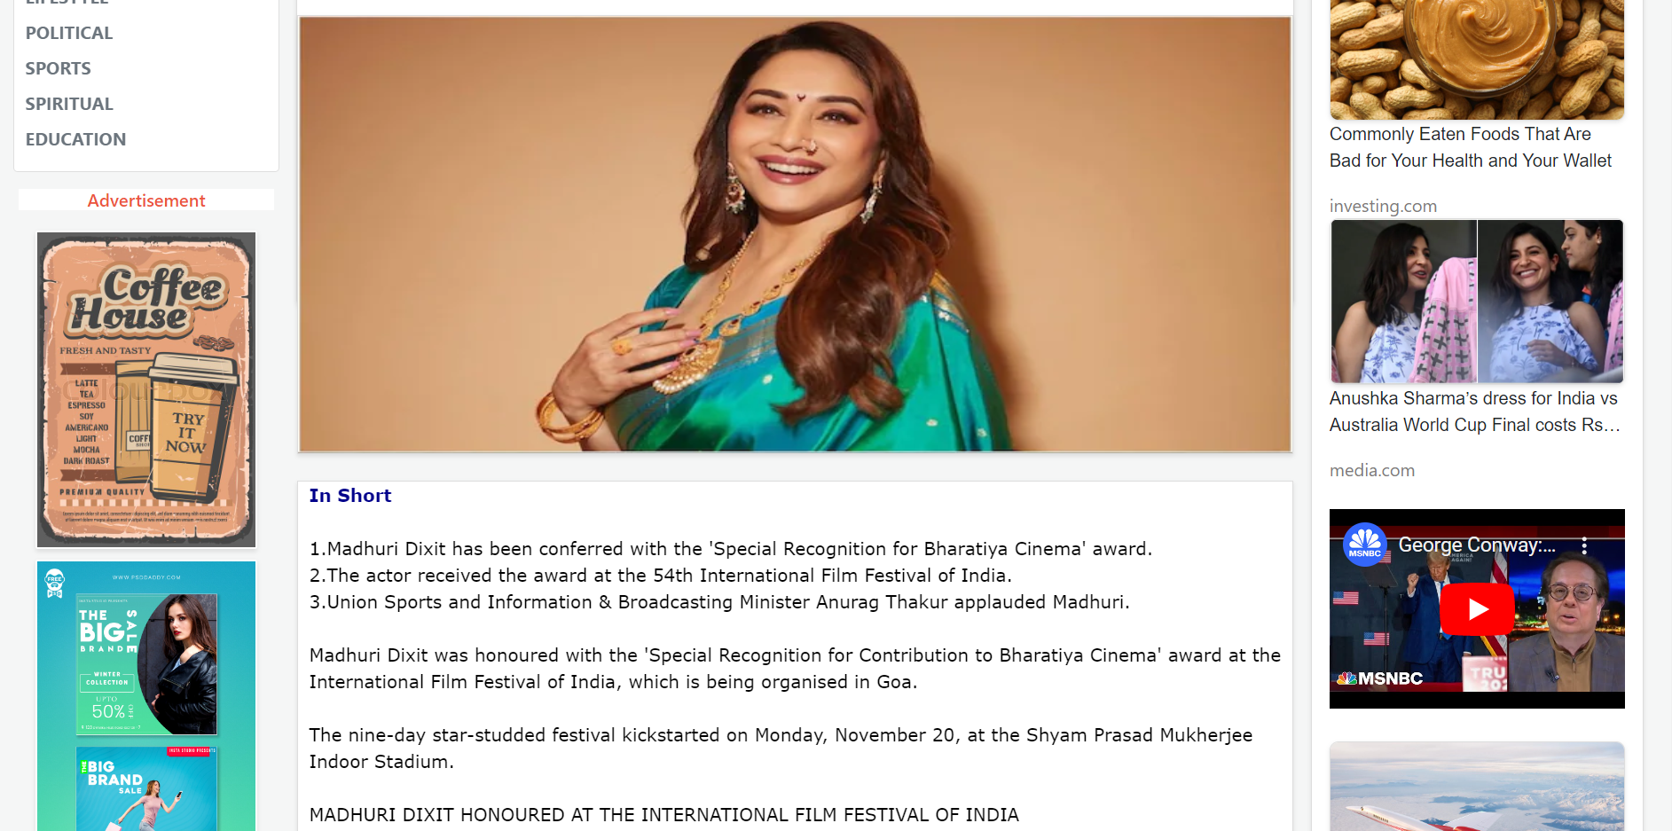
Page Details

Slide 19
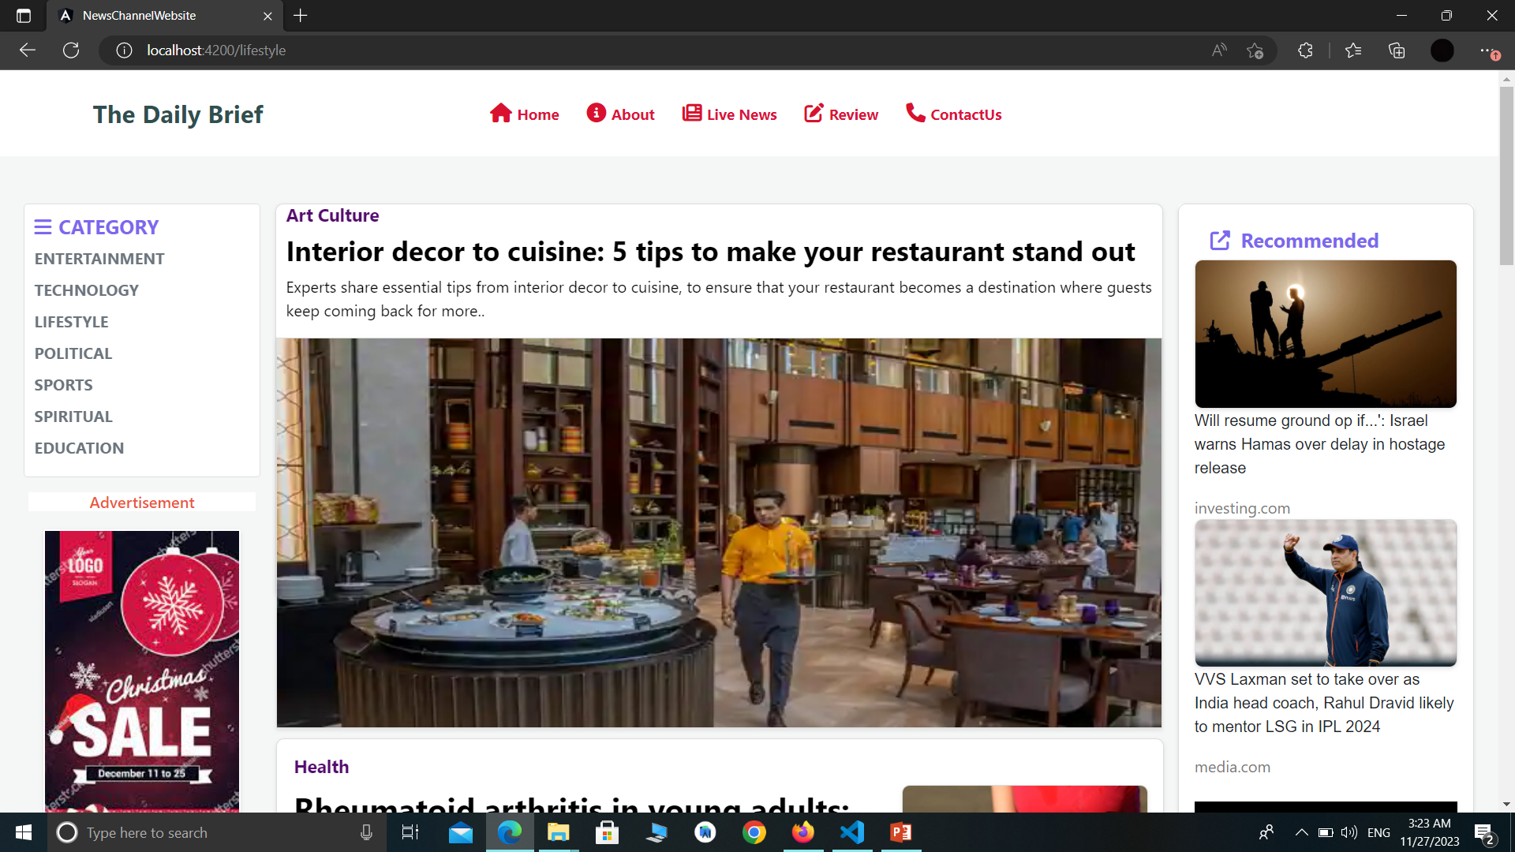
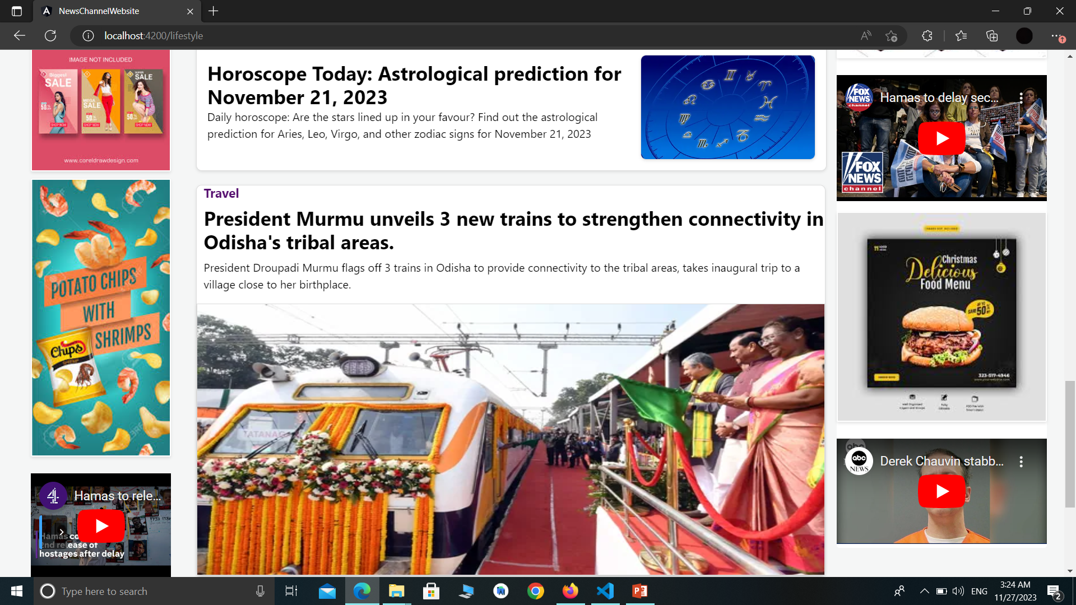
Lifestyle
Category

Slide 20
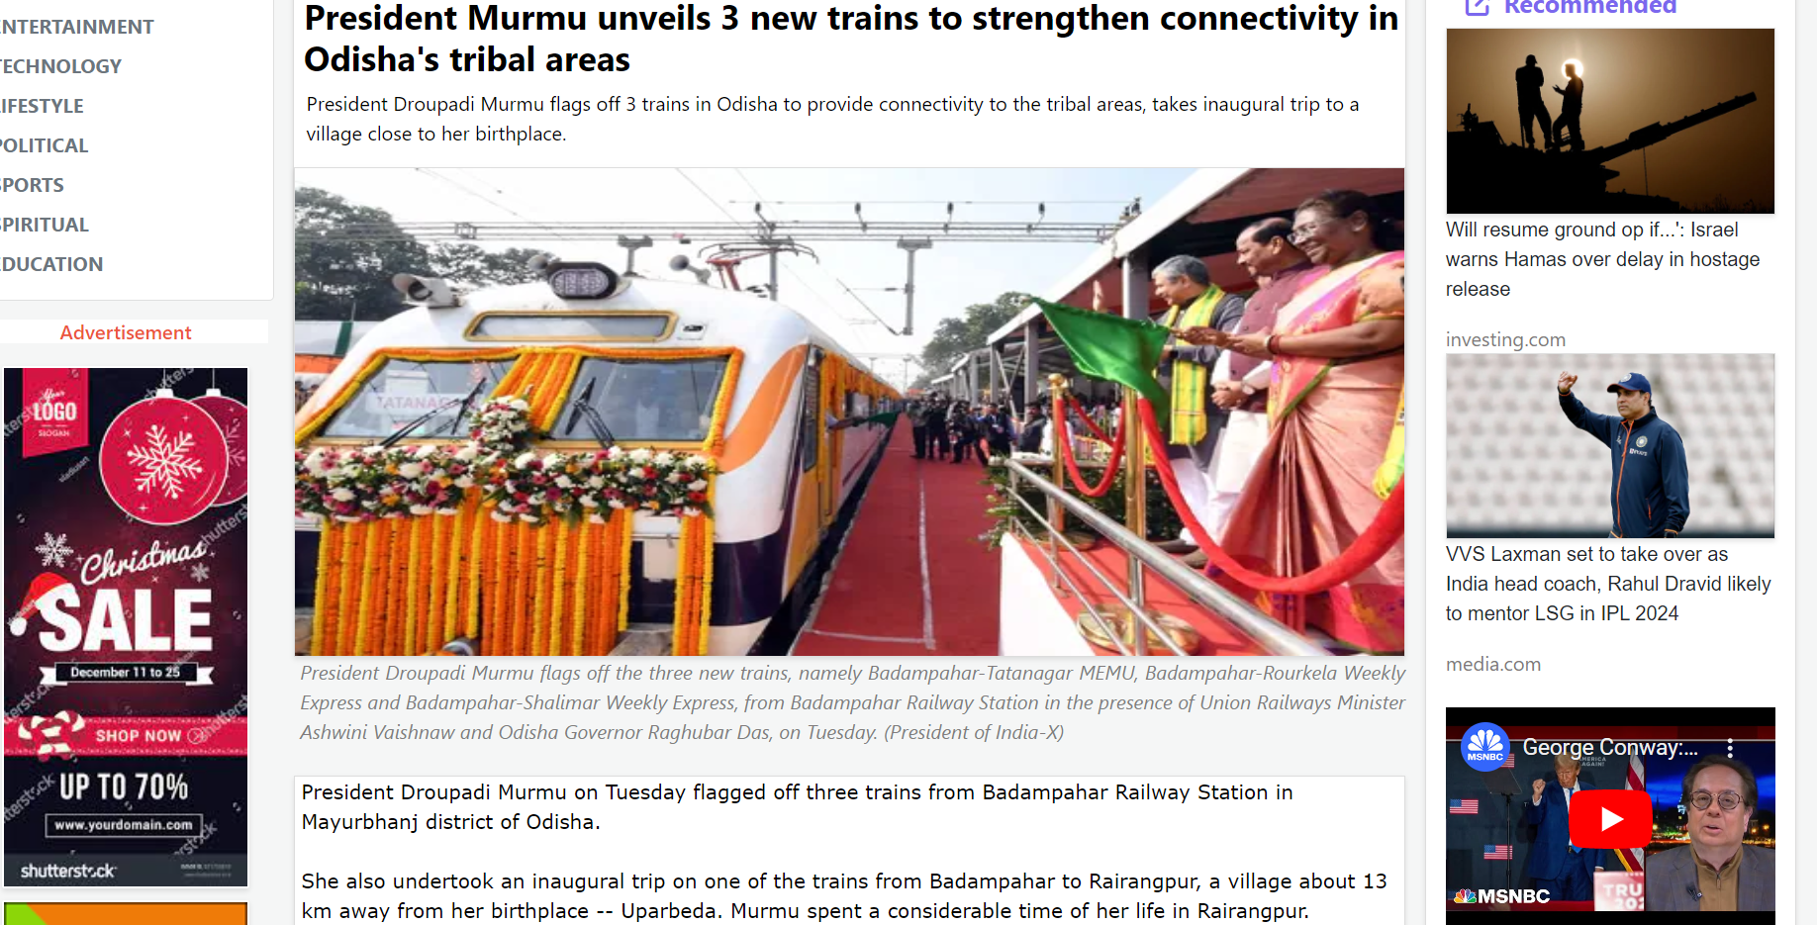
Page Details

Slide 21
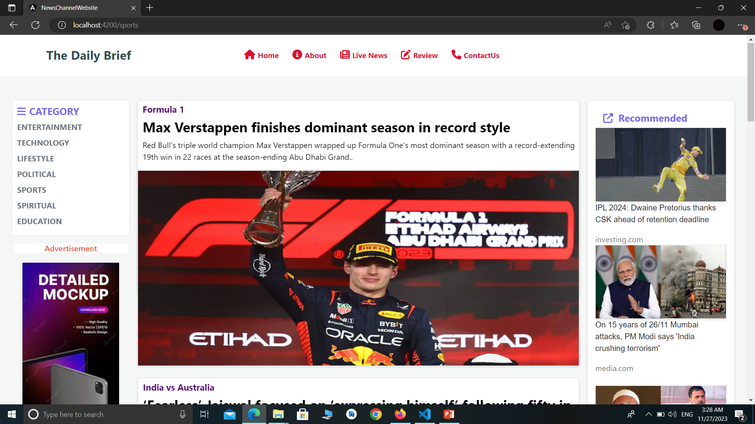
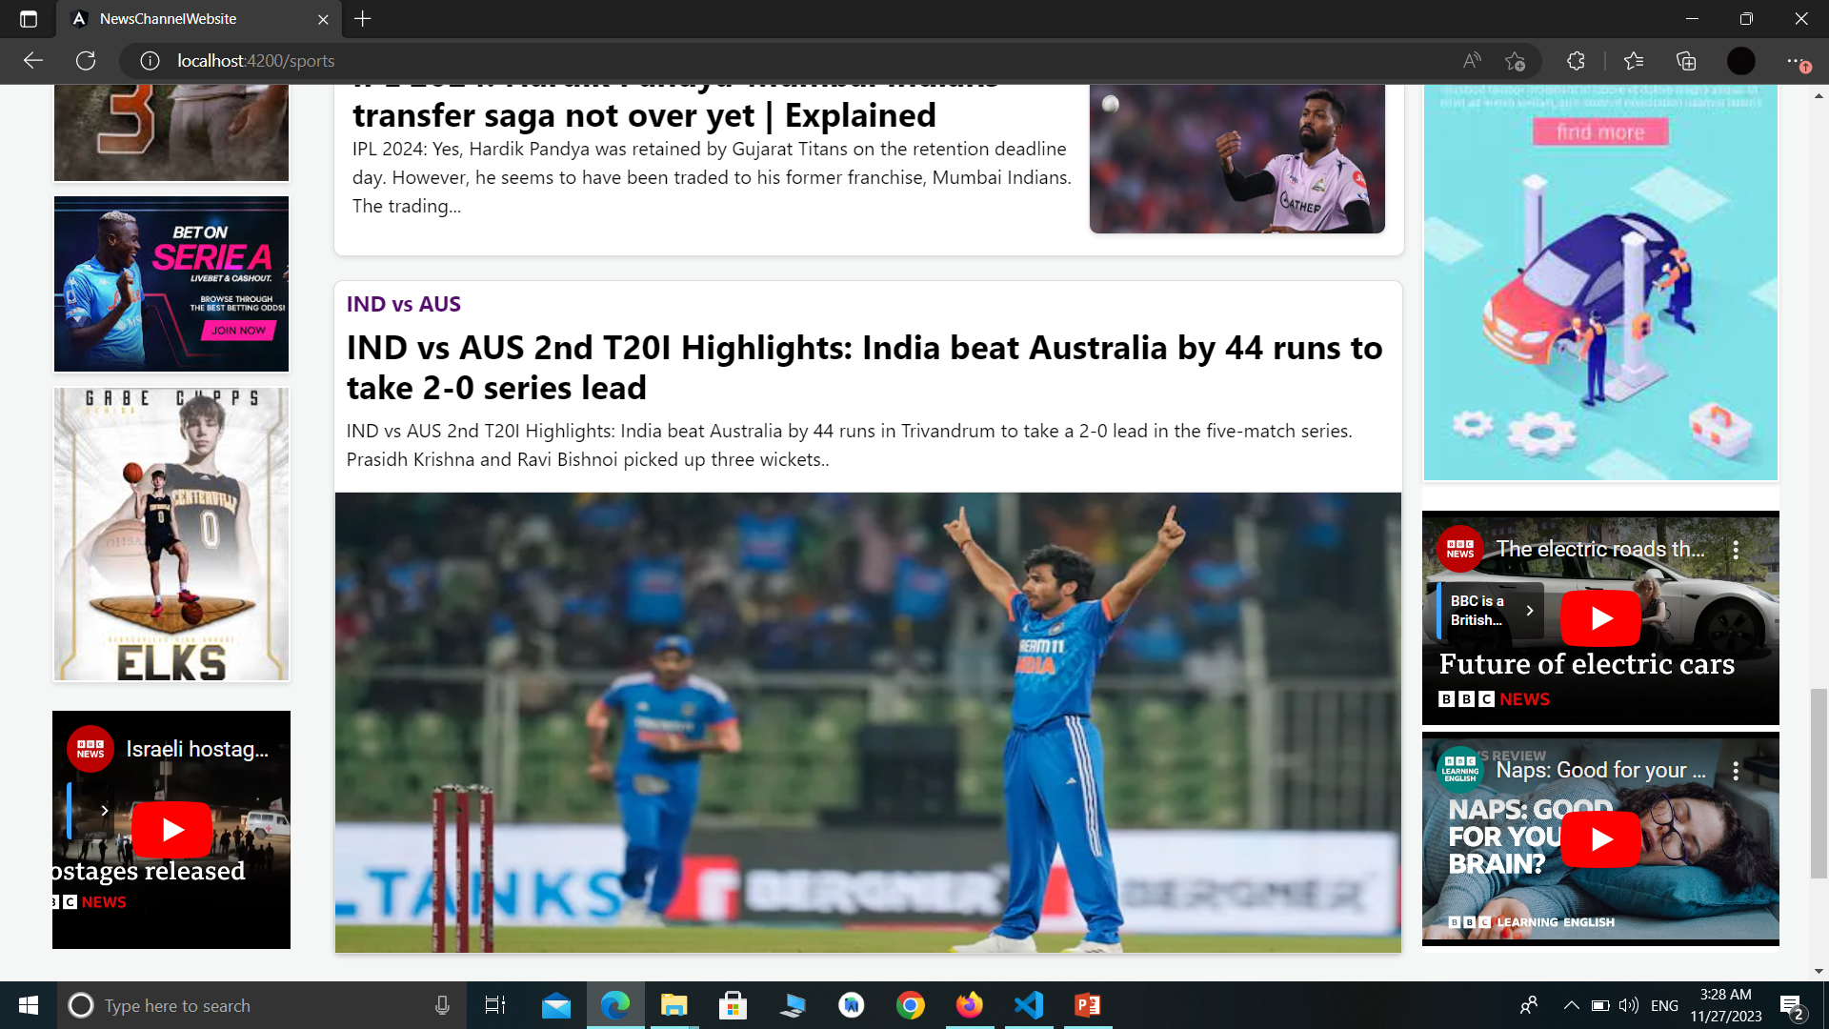
Sports
Category

Slide 22
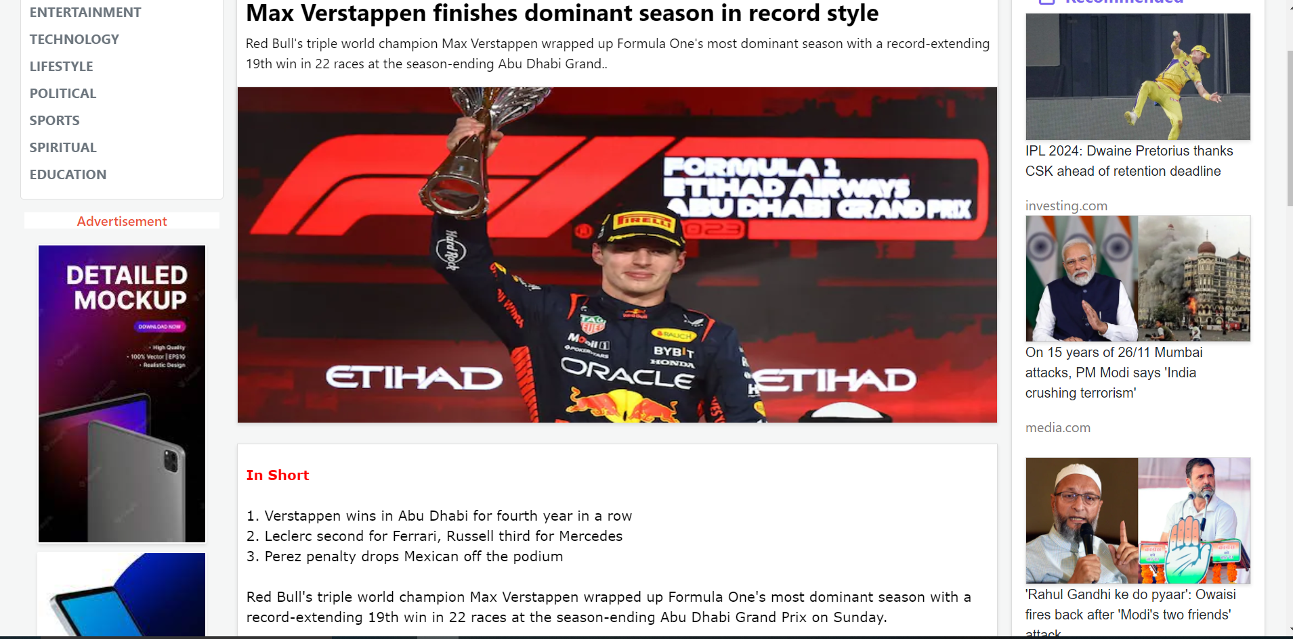
Page Details

Slide 23
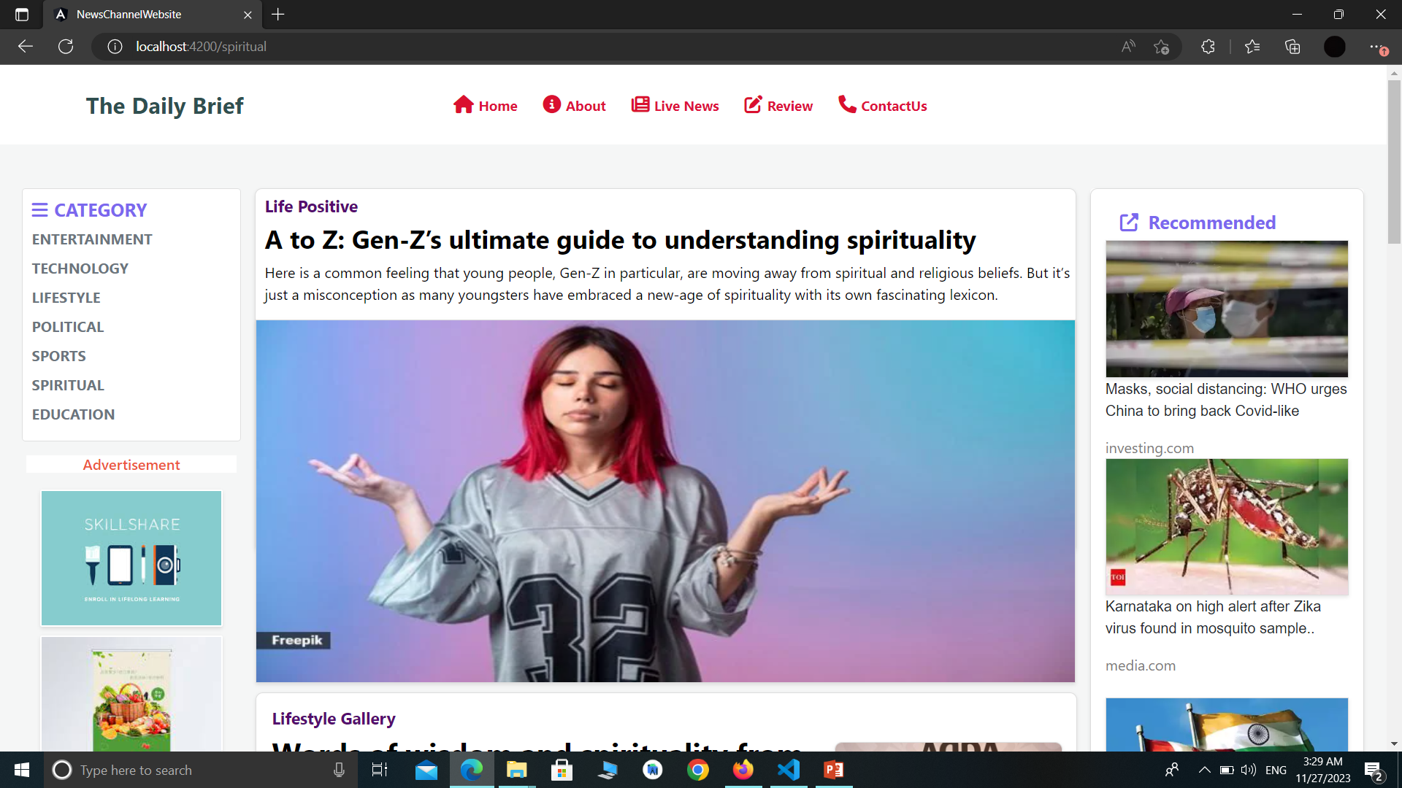
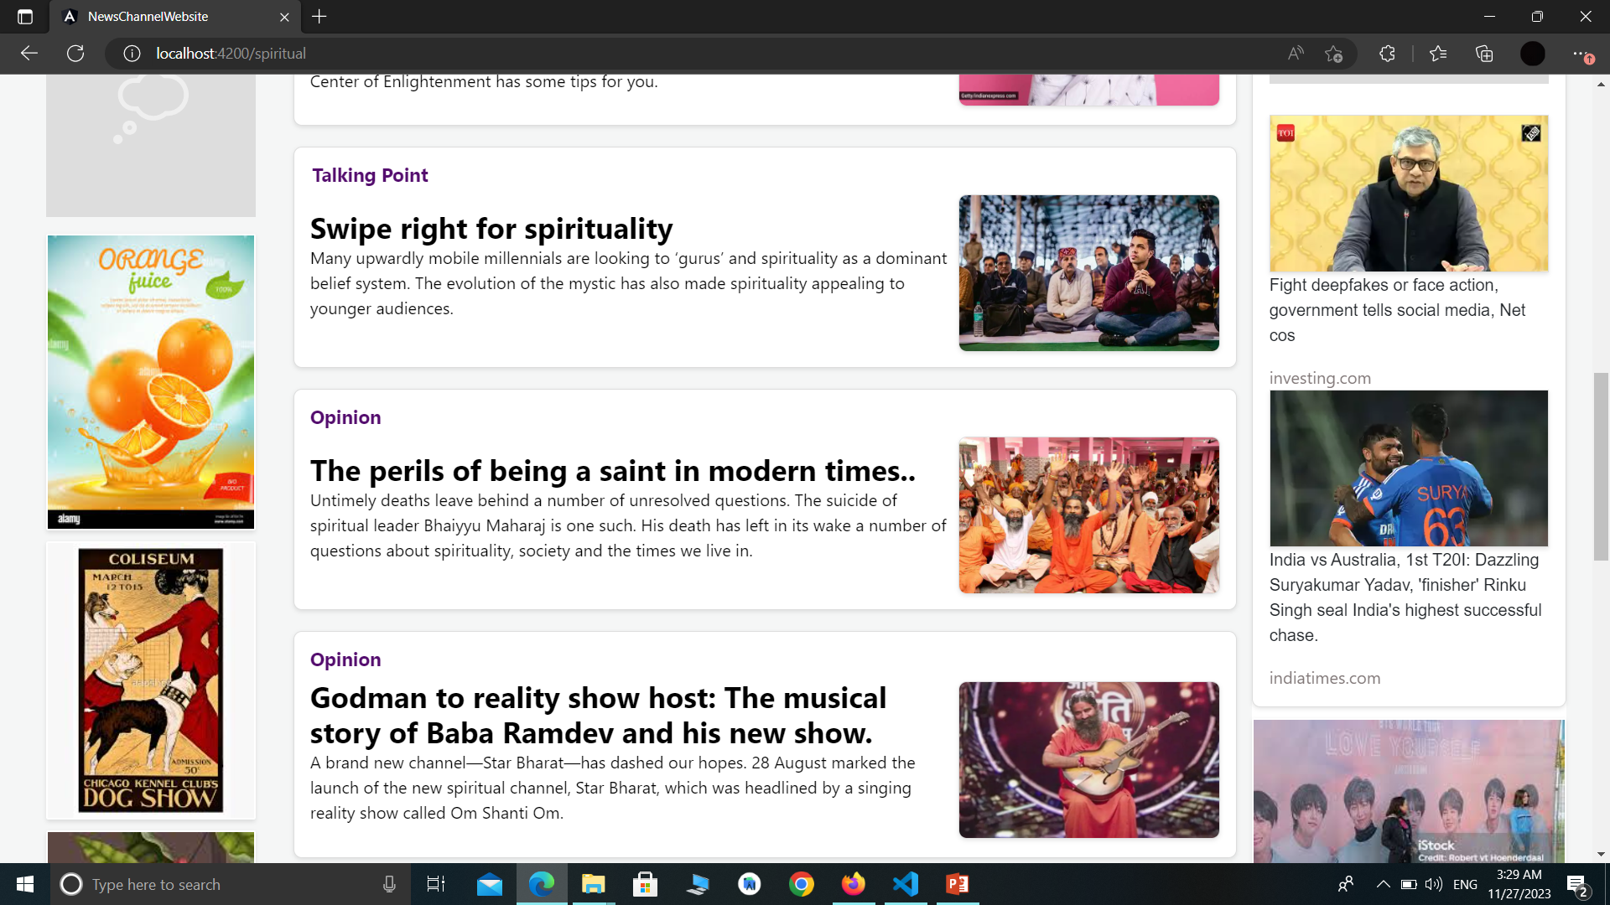
Spiritual
Category

Slide 24
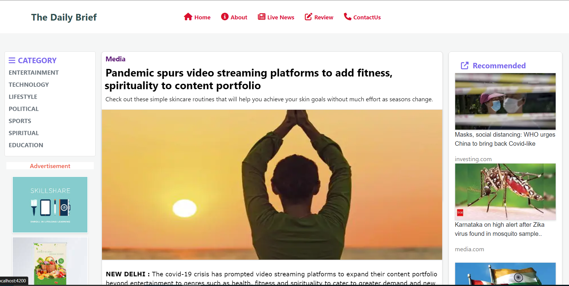
Page Details

Slide 25
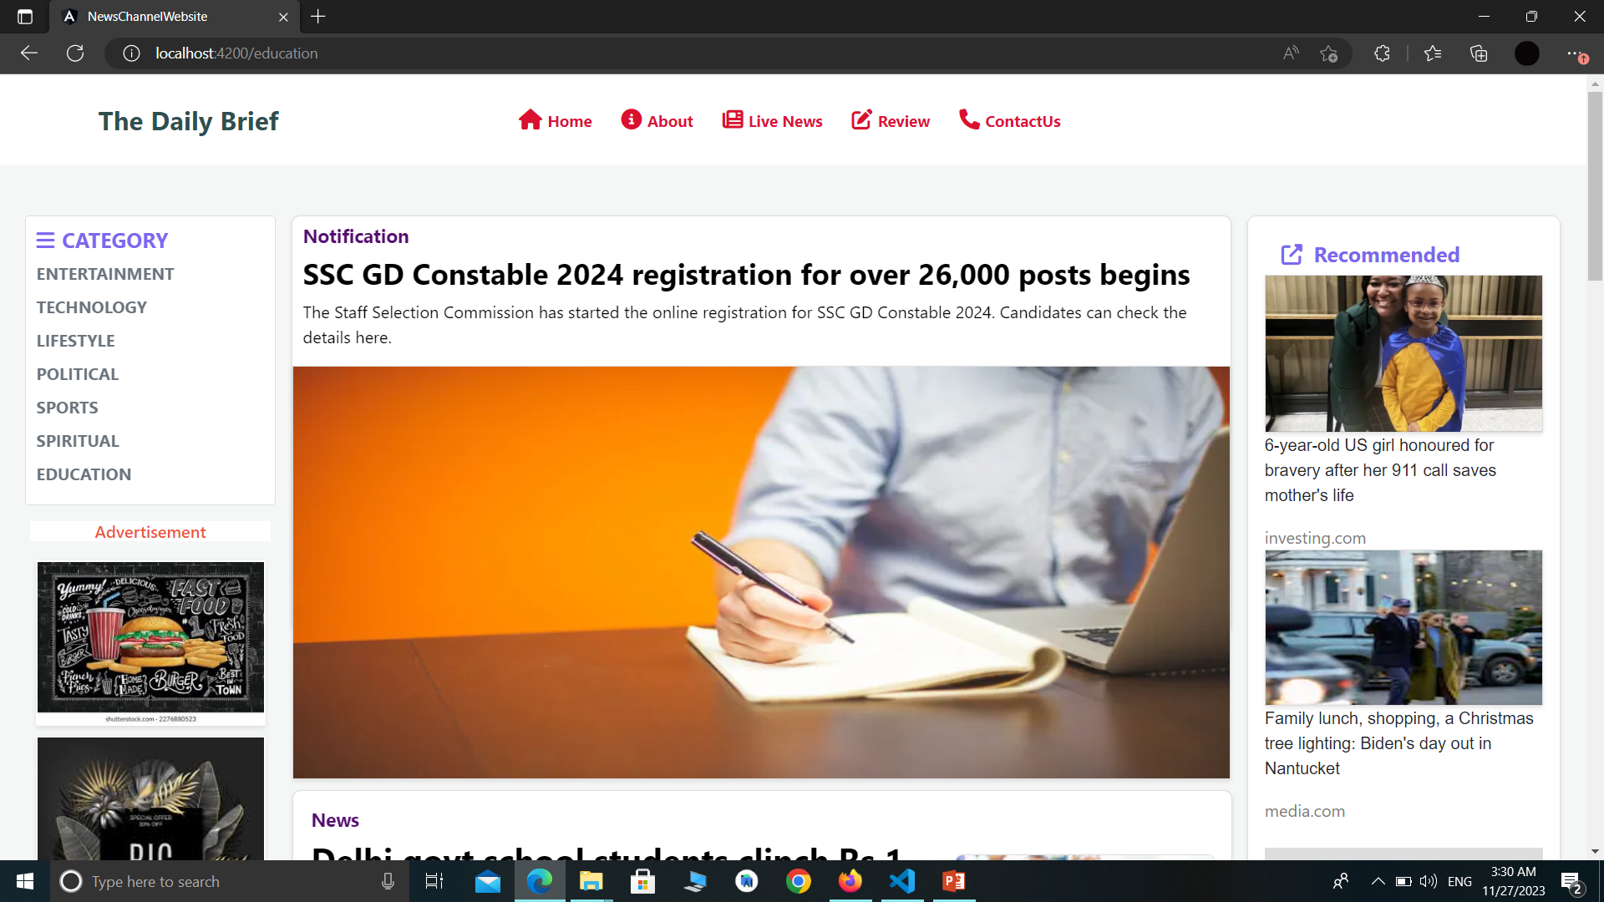
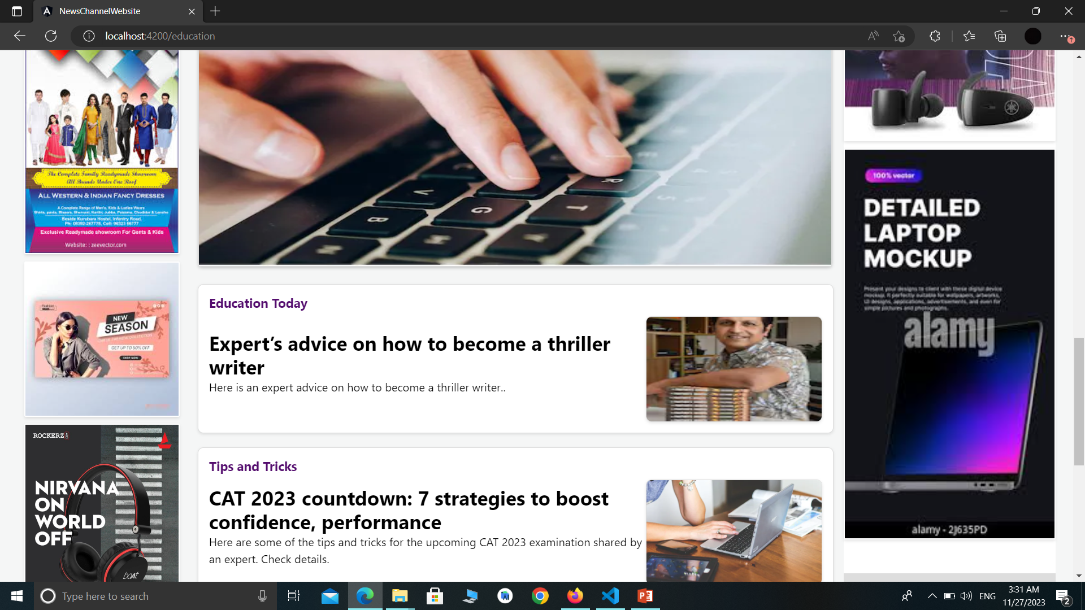
Education
Category

Slide 26
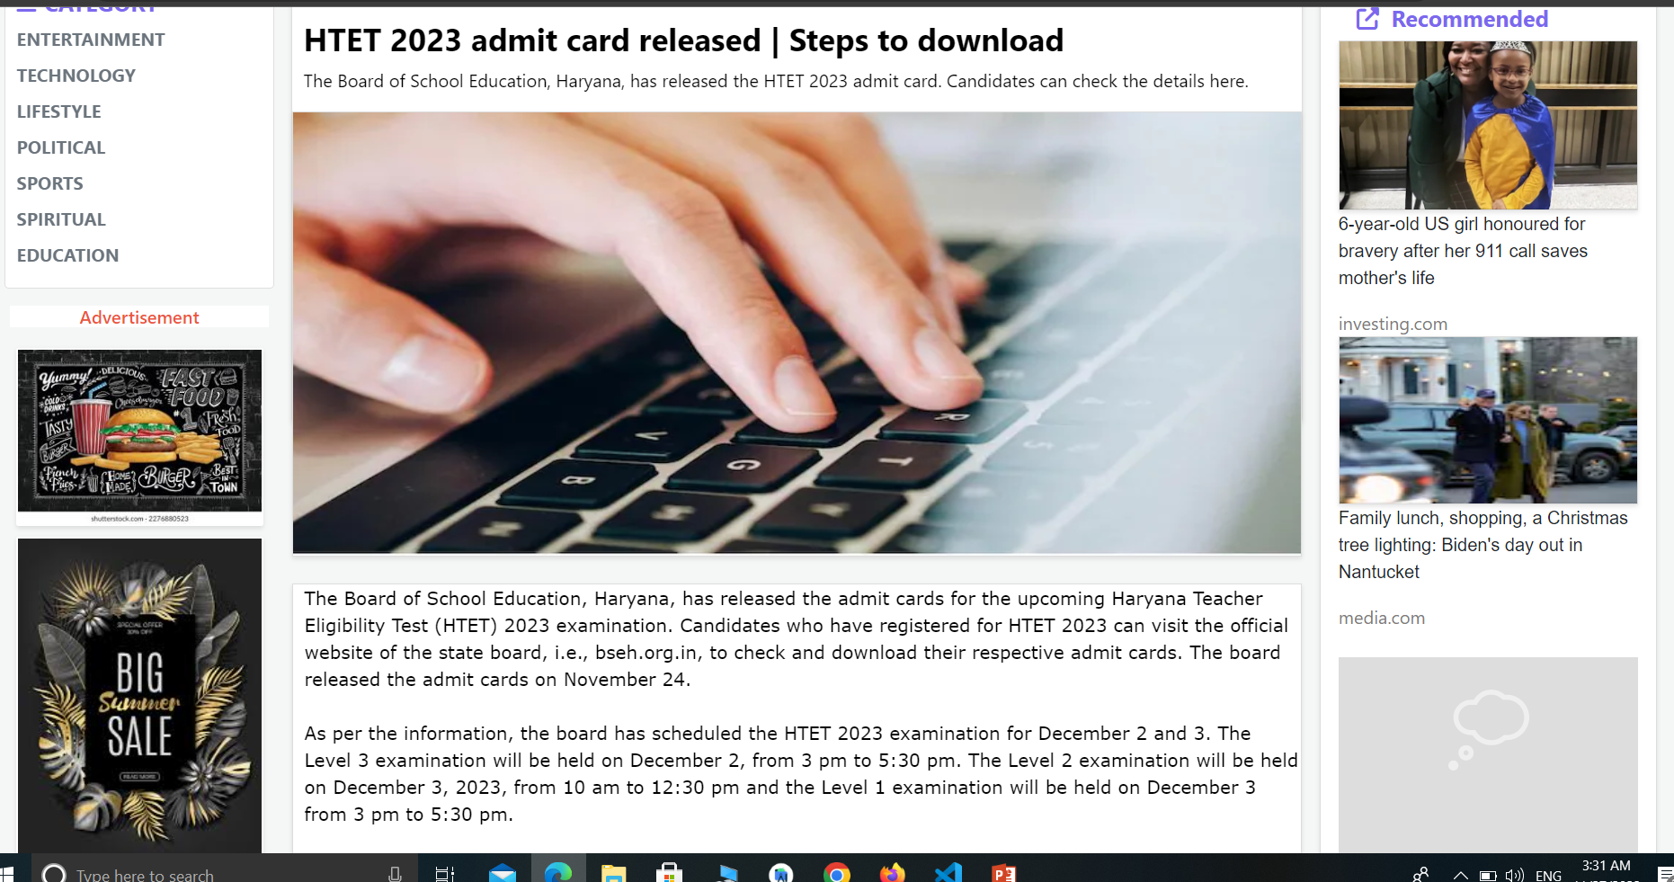
Page Details

Slide 27
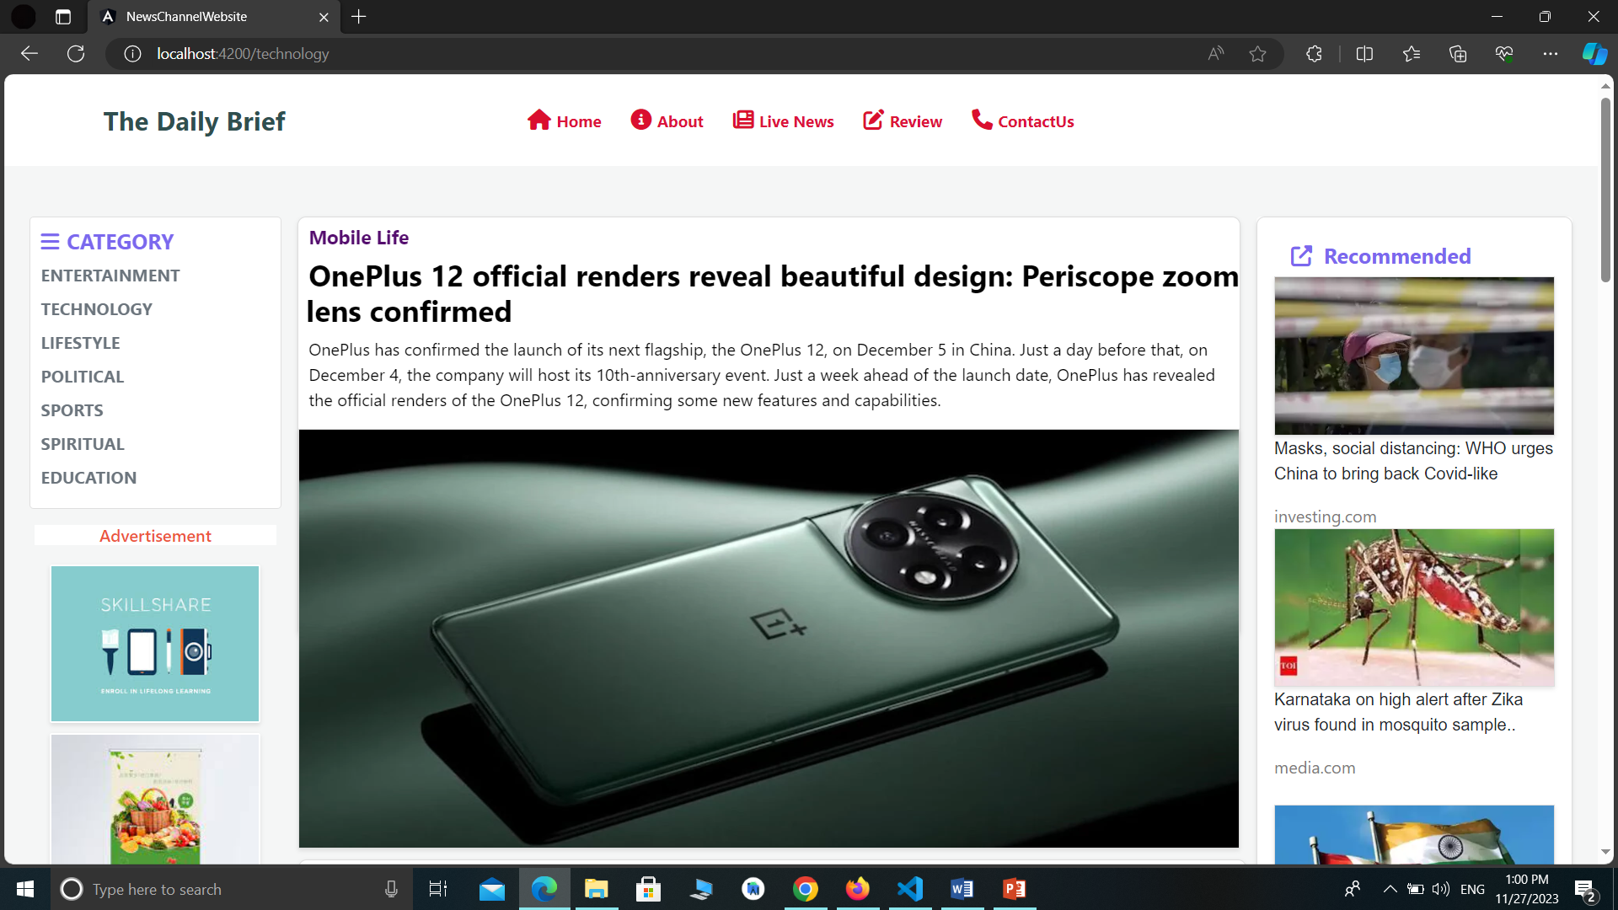
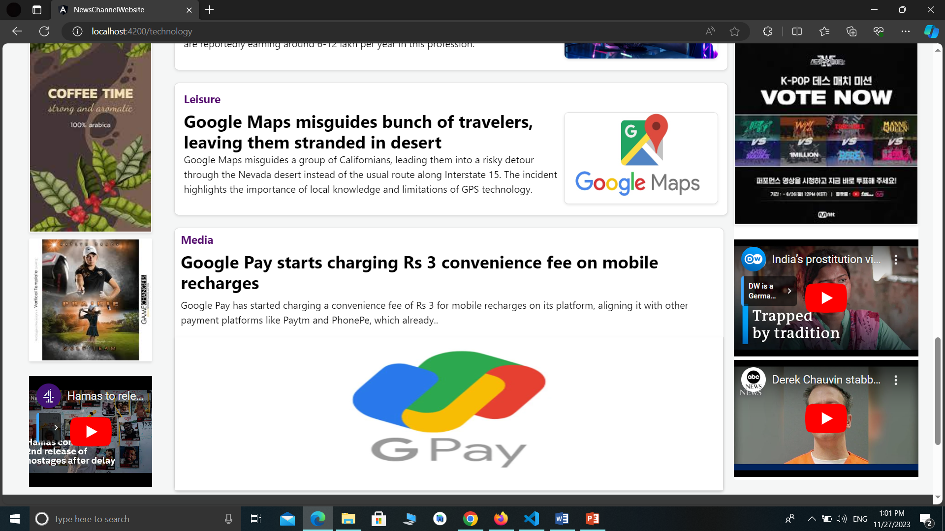
Technology
Category

Slide 28
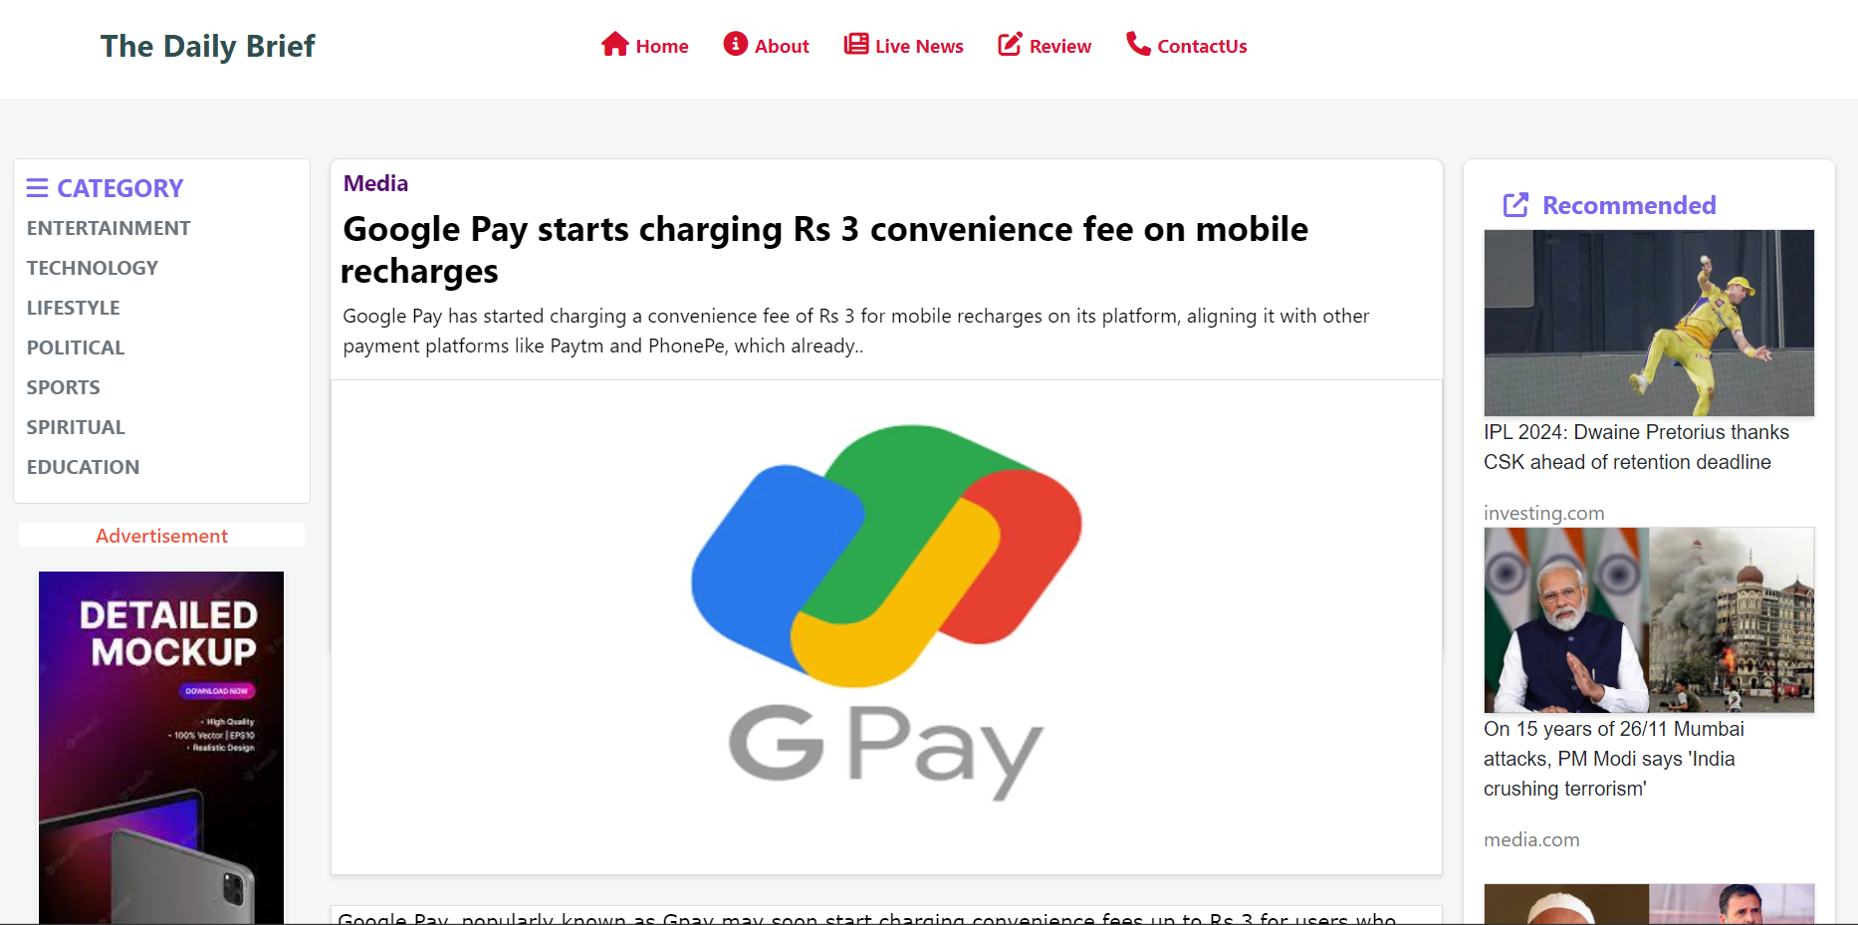
Page details

Slide 29
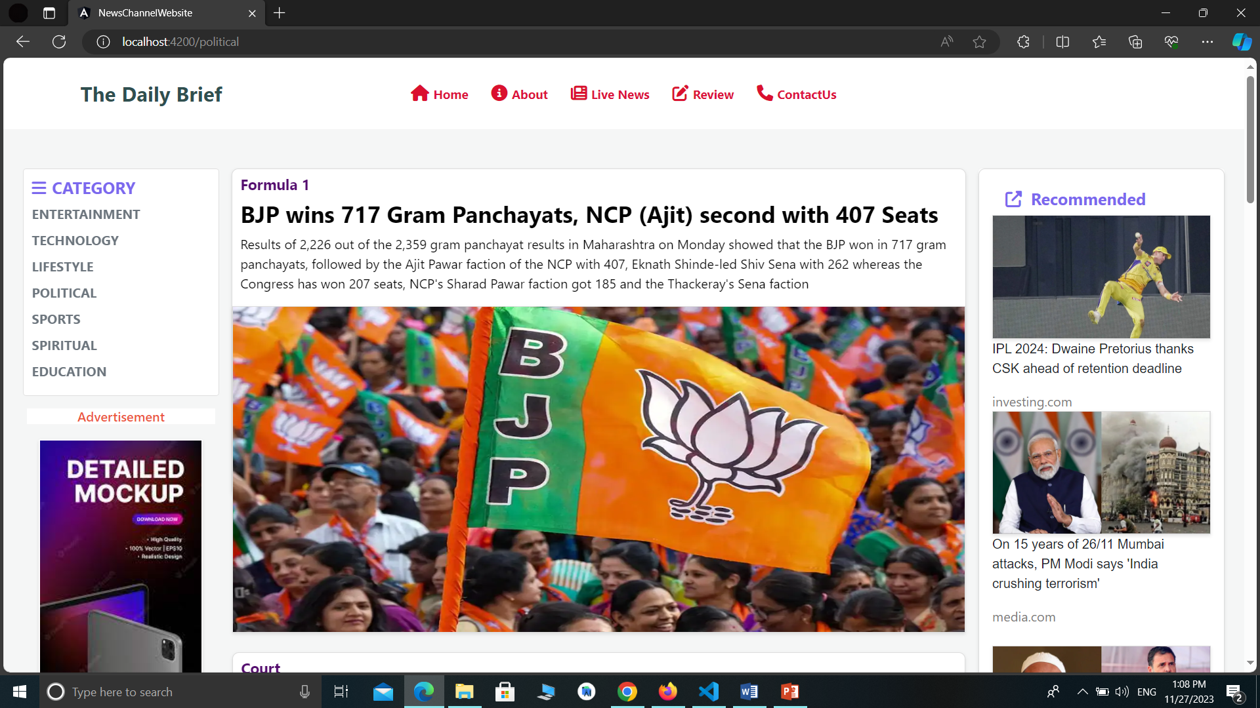
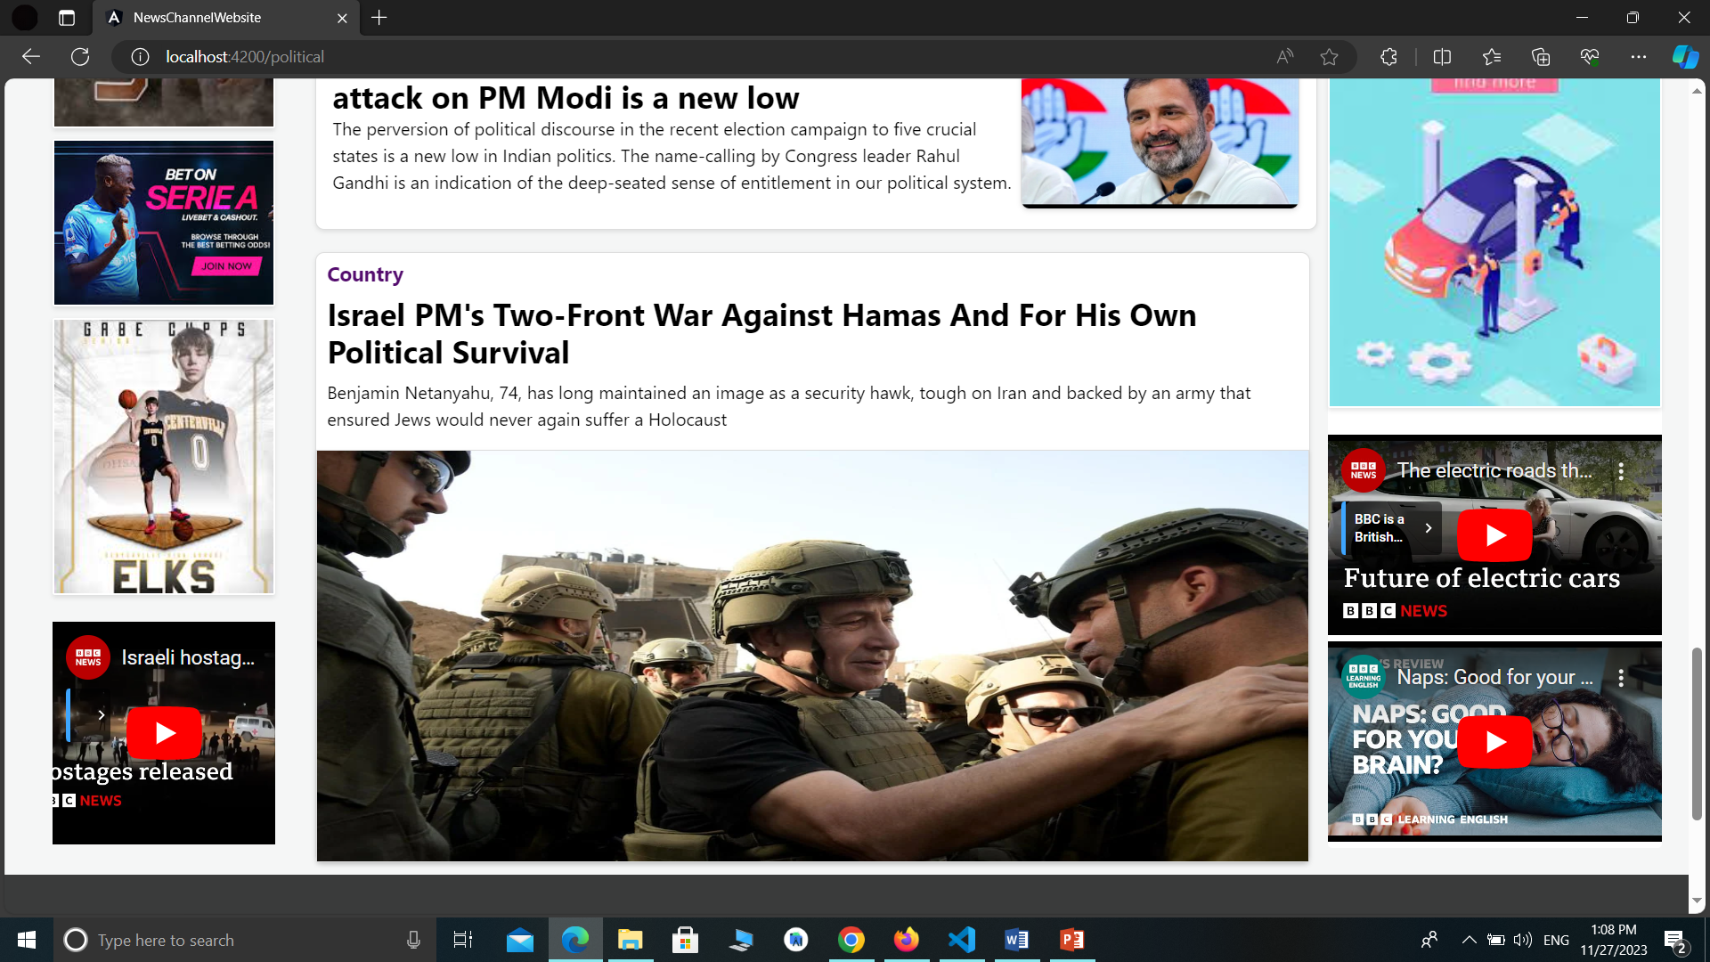
Political
Category

Slide 30
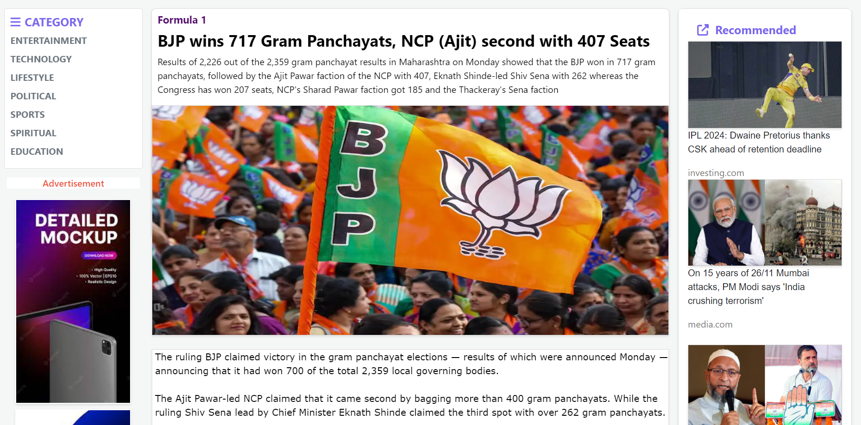
Pages Details

Slide 31
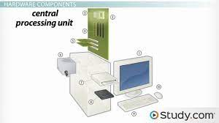
Hardware Requirement
Processor: 2 GHz processor.
RAM: 50 MB
Hard Disk: 5 GB free hard drive space.
Speed : 2 GB of RAM
Audio : Speakers or headphones, and microphone
Bandwidth : Minimum of 512kbps
Video : Webcam
Printer : Any Laser printer
Mouse
Keyboard

Slide 32

SOFTWARE REQUIREMENTS
This Software will run on any windows platform (NT, XP, Windows
7,10 2000) operation system. Angular should be Preferable
installed on the machine.
Operating System: Windows 10
Front-End: HTML , CSS, Angular Javascript, Bootstrap,

Slide 33

DRAWBACKS AND LIMITATIONS
The current system is very time consuming.
We don’t manage news reporting system.
System break down makes staff work to stop.
Improper coding of the system damages the business.
Sensibility level could not add.
The System being large has its flaw of maintenance.
As due to large Size the maintenance of the System in the Long run becomes difficult
Attention And Emotional Development
It is not suitable application for emergency needs.

Slide 34

FUTURE SCOPE
We will manage news reporting system.
We make video conferencing system.
We update our database.
Sensibility level could be added.

Slide 35
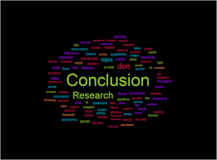
CONCLUSION
In our Project work, an attempt has been made to develop a news or information based web site . We develop this project that helps people and make them aware so that they can know any news. To establish this website we use various methodologies . To develop this project we have faced many problems but we hardly tried to developed this project.

Slide 36


